Slide 1


TTC - Mestrado em Microbiologia APLICADA
IE - MESTRADO EM MATEMÁTICA APLICADA ECONOMIA & GESTÃO
ITT – Engenharia Biomédica e Biofísica
IE - OPCIONAL PARA 2º CICLO
FCUL – 2018/2019
AULA 4
25 Março 2019
Helena Vieira
Copyright ©

Slide 2
Sumário
Proposta de valor. Conceito de valor na exploração/comercialização de novos produtos.
A Proposta de Valor no modelo do Business Model canvas.
Curvas de Valor
Avaliação da atractividade de oportunidades de negócio.
Código PI da UL. Protecção da propriedade intelectual/patentes.

Slide 3
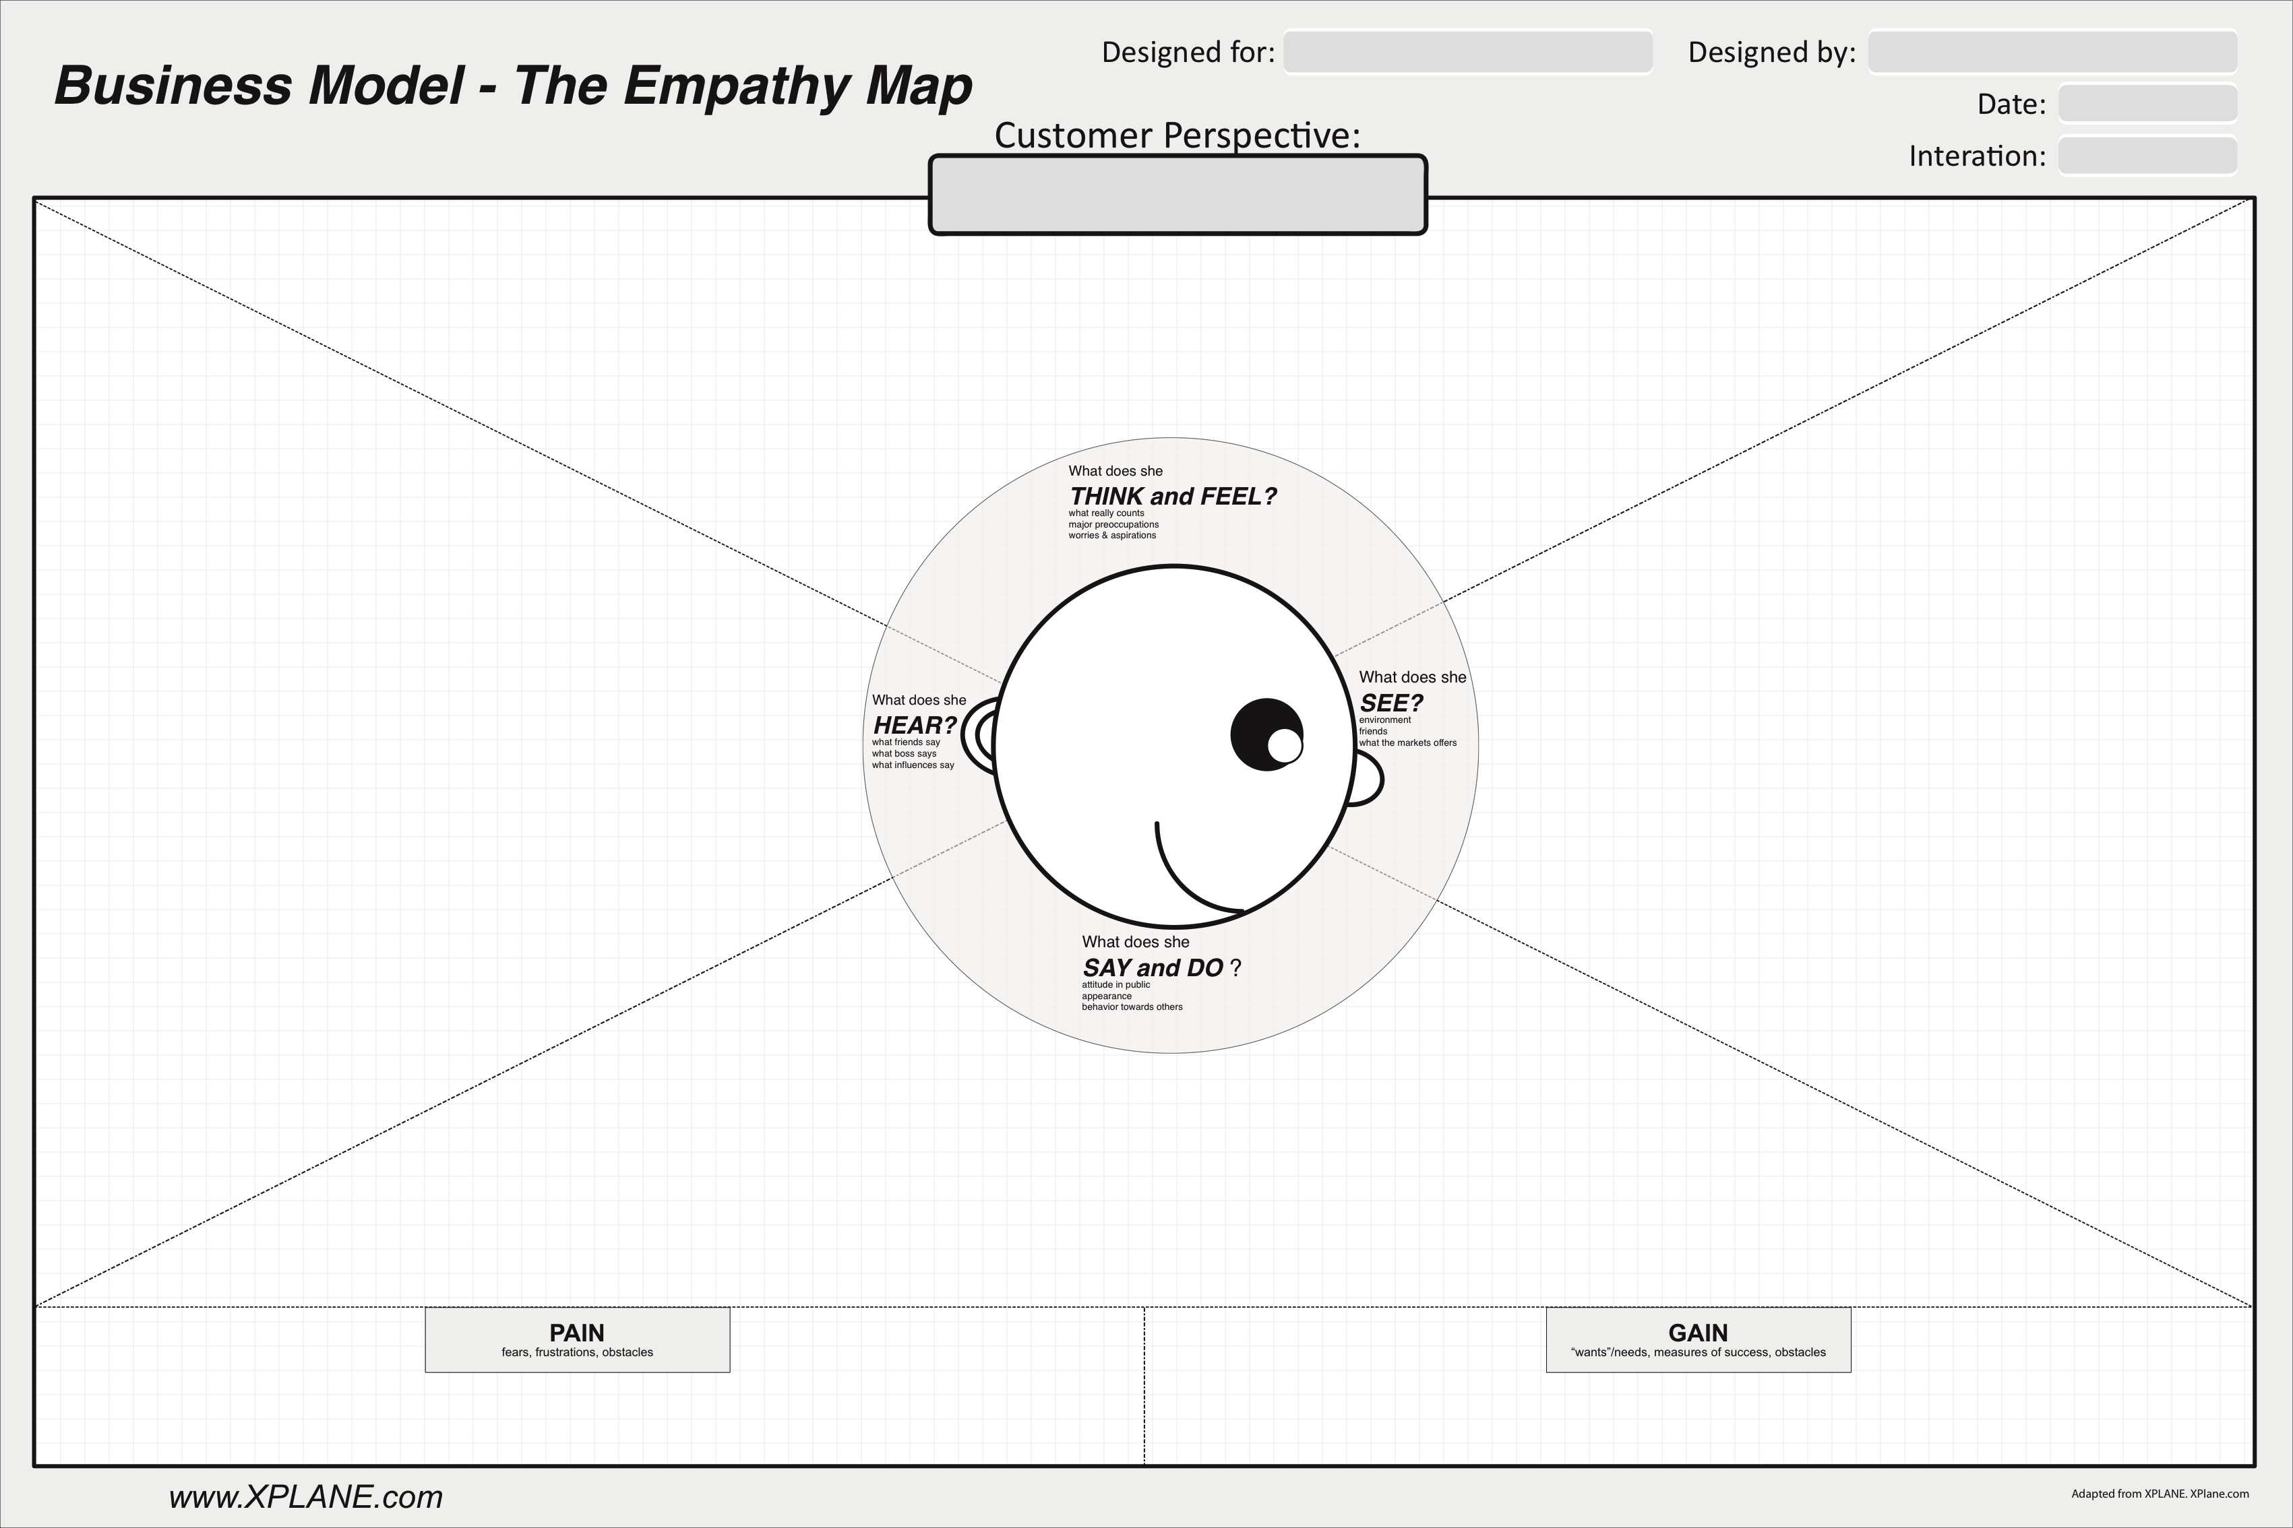

Slide 4
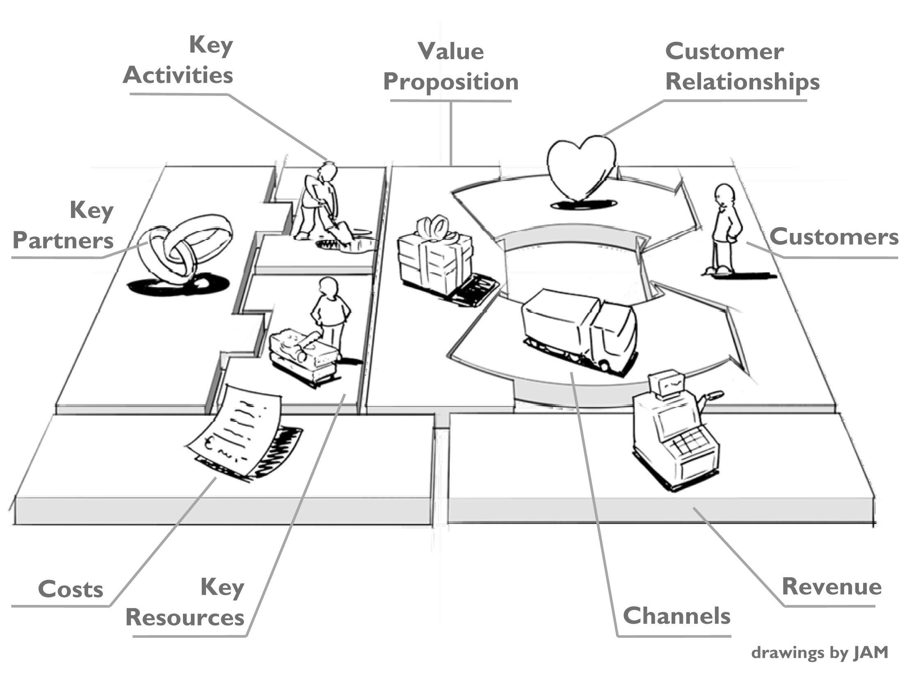
BUSINESS MODEL CANVAS
in: Business Model Generation, Alex Osterwalder & Yves Pigneur, 2009

Slide 5
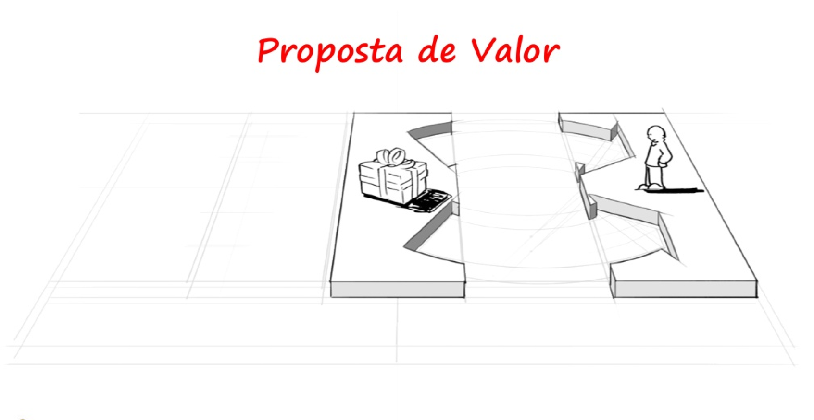
VALUE PROPOSITION

Slide 6
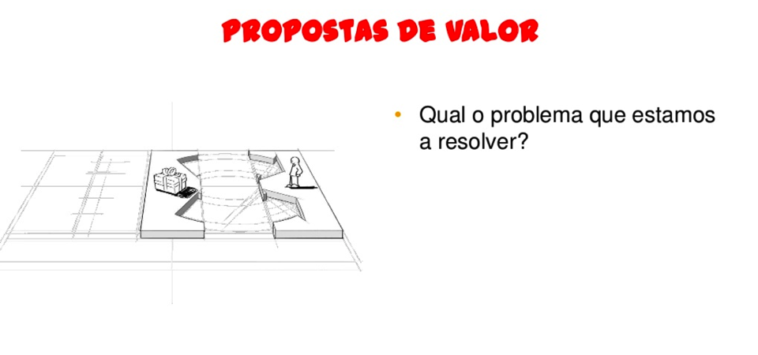
VALUE PROPOSITION
What problem/pain are we trying to solve?
What solution are we offering?
What is the value in our solution?

Slide 7
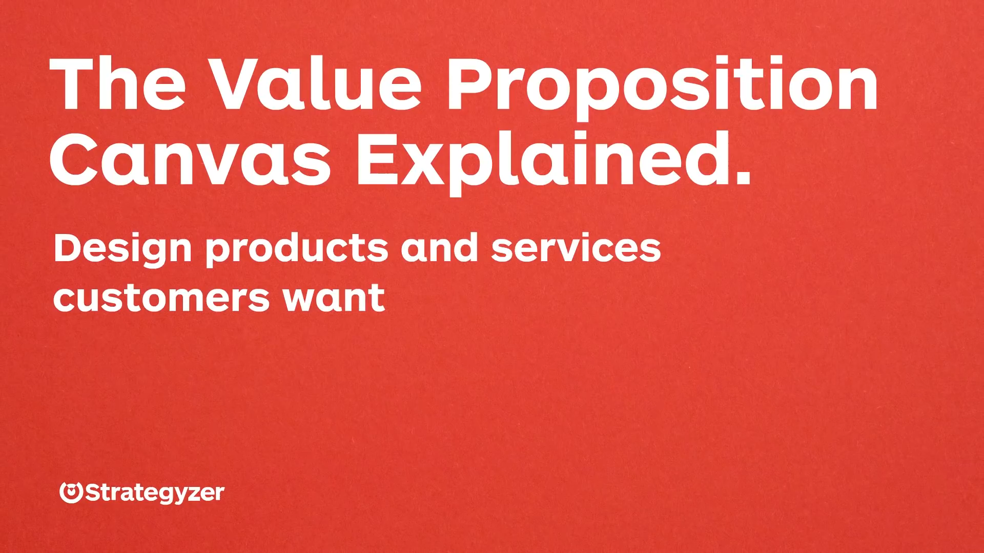

Slide 8
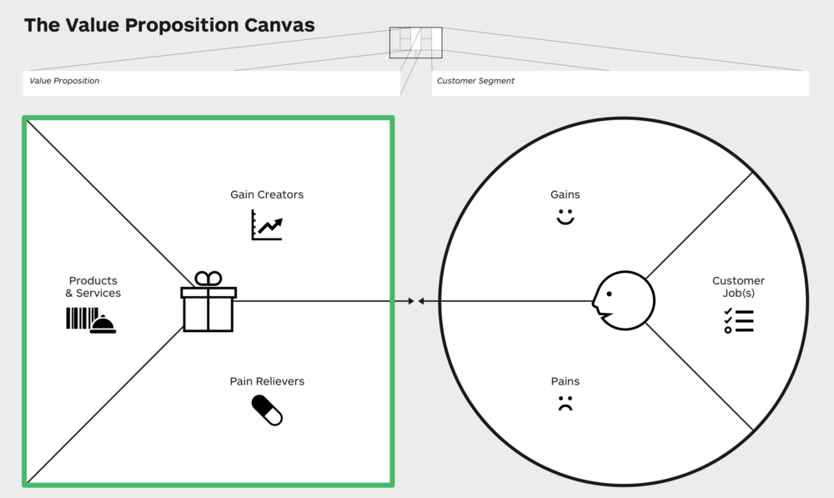

Slide 9
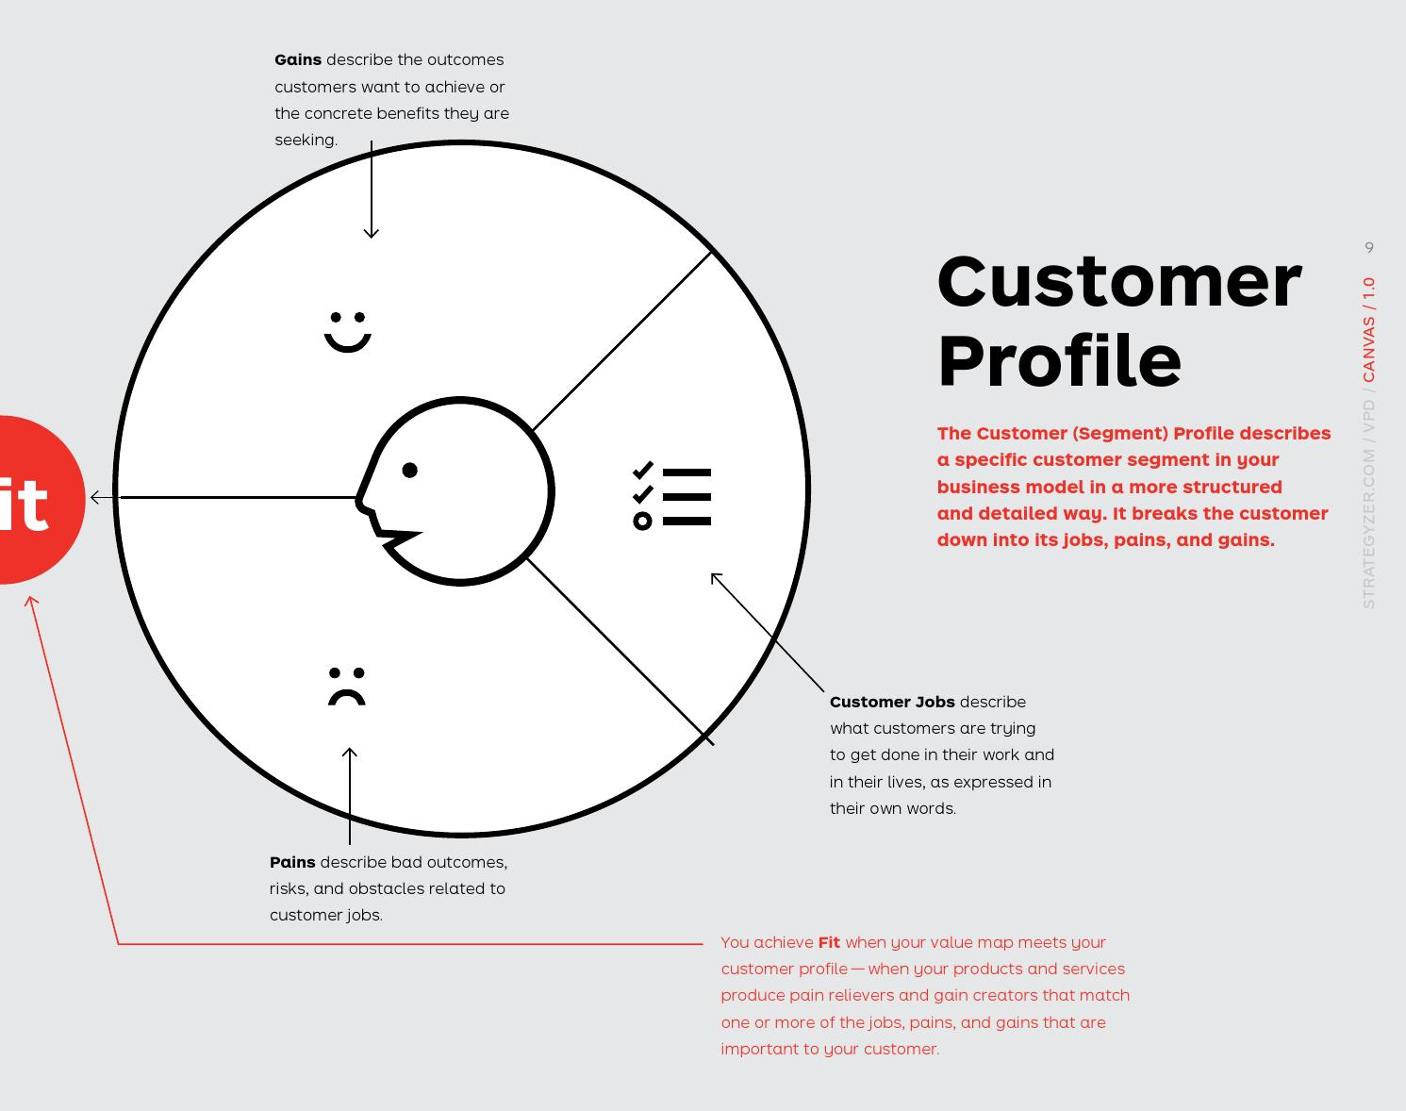

Slide 10
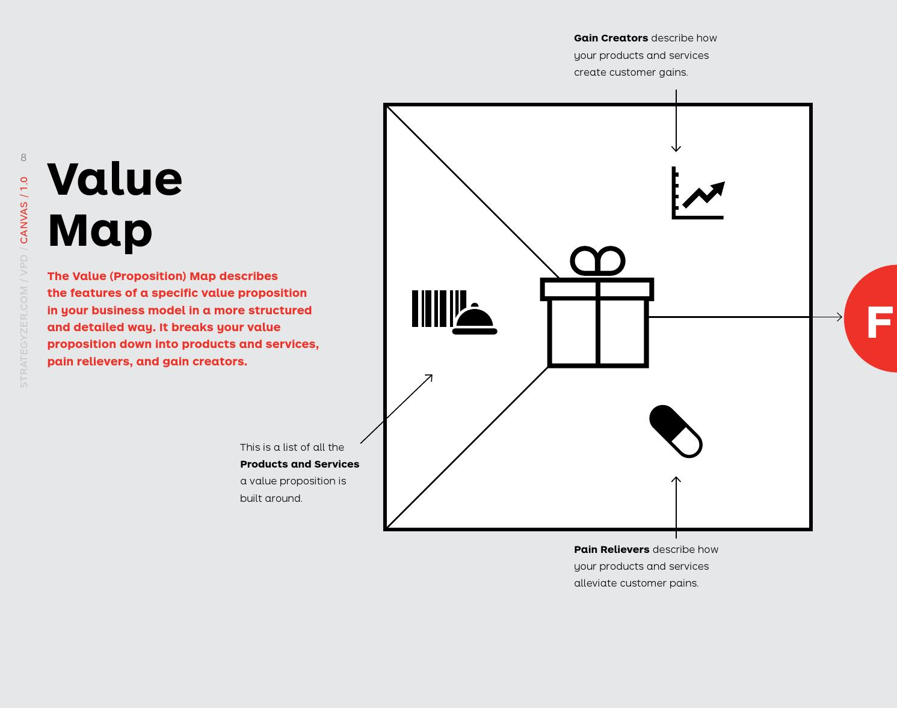

Slide 11
VALUE PROPOSITION
A business or marketing statement that summarizes why a consumer should buy a product or use a service.
This statement should convince a potential consumer that one particular product or service will add more value or better solve a problem than other similar offerings.
Source: Forbes magazine

Slide 12
VALUE PROPOSITION – WRITE IT RULES
Keep it short and uncluttered. If you can't sum it up in 10 words or less, chances are you won't be able to execute it either.
Be precise. Your customers have specific needs; your value proposition should offer targeted solutions
This is about your customer, not you. Your value proposition should discuss only what matters to your customers and the value you can bring to them.
Value comes in numerous forms. Money, time, convenience and superior service are a few of the ways you can help deliver value to your customers.

Slide 13
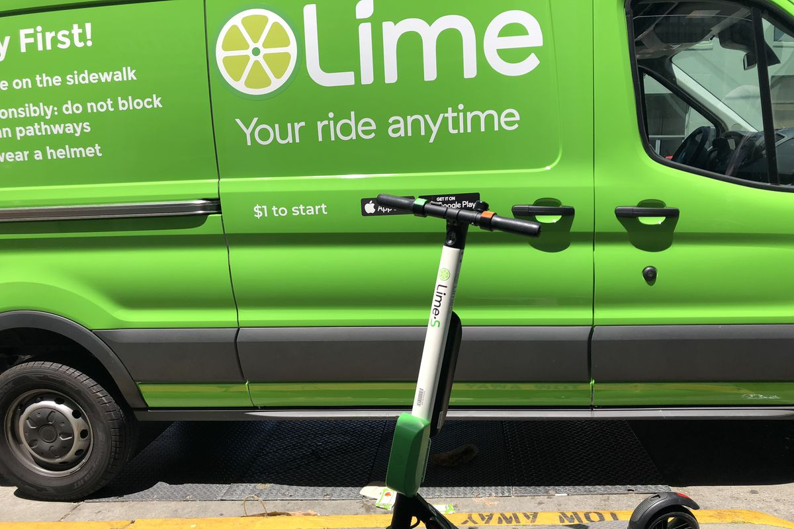

Slide 14
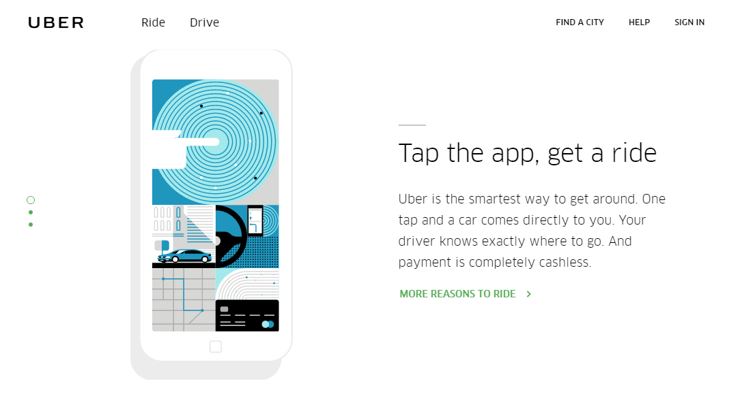

Slide 16
VALUE CURVE
“Strategy is what a company decides NOT to do well”
Francis Frei, Harvard Business School

Slide 17
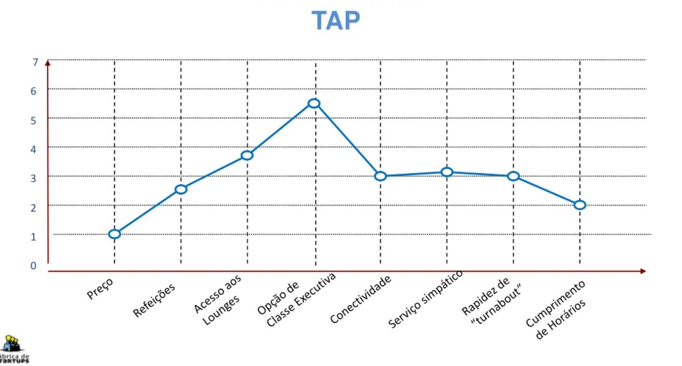
VALUE CURVE

Slide 18
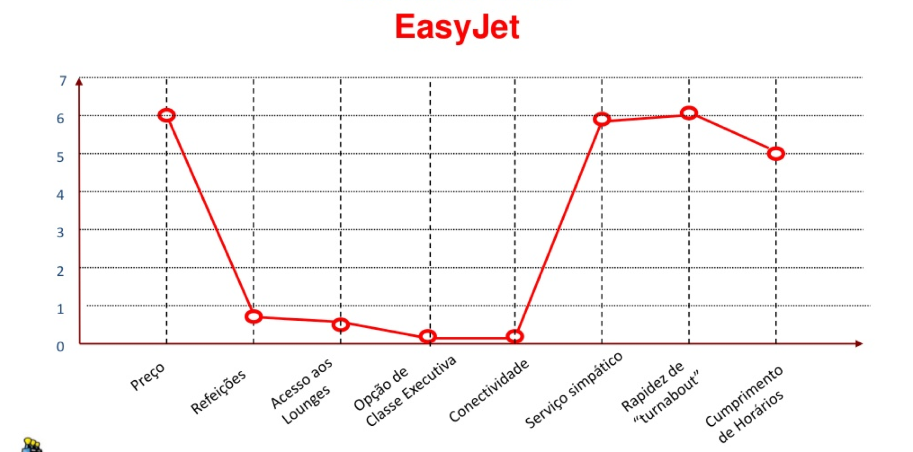
VALUE CURVE

Slide 19
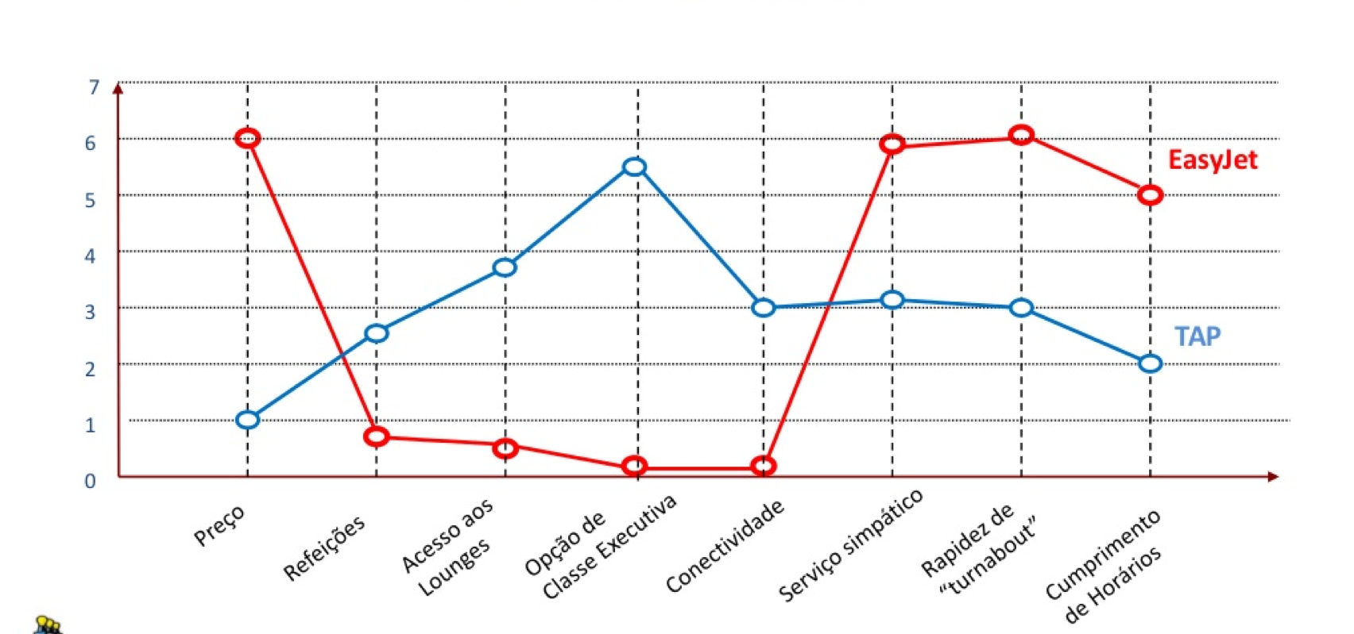
VALUE CURVE

Slide 20
HOW CAN YOU INCREASE VALUE EVEN MORE?

Slide 21
BLUE OCEAN STRATEGY
Theory of Strategy developed by INSEAD teachers W.Chan Kim & Renee Maugbourne.
DO NOT focus on competing in EXISTING MARKETS
Rather, focus on CREATING NEW MARKET SPACES and making the competition IRRELEVANT.

Slide 22
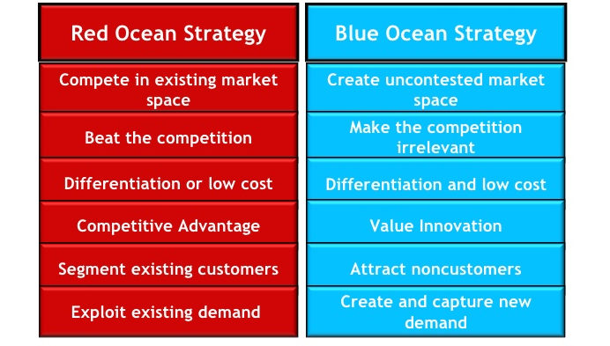
BLUE OCEAN Vs RED OCEAN

Slide 23
EXERCISE – VALUE CURVE
Attribute identification
Get all the elements of your group together
Each one will individually think and write on 5 post-it the 5 key differentiation factors from your competition
Put all post it together
Group the post it in similarity attributes groups
Select the most relevant 8 and build your value curve (scale 1-7)

Slide 24
VALUE CURVE ATTRIBUTES
Design
Convenience
Availability
Price
Exclusivity
Personalized
Faster access
Eco-labbeled
Organic
Simplicity
Ambience
Fun
Knowledge access
Quality
Capacity
Variety
Location…

Slide 25
VALUE CURVE
Questions you should ask (Francis Frei)
What is the experience your clients want?
What are the attributes your clients value the most?
Can we distinguish ourselves from our competition by the experience we can provide our clients?

Slide 26
WHAT WE WANT YOU TO DO!

Slide 27
Notes:
ITERATIVO

Slide 28
WHAT CAN I TEST?
Interest & relevance
Willingness & ability to pay
Preferences & priorities
Notes:
Crescente!
Estou interessado –> estou disposto/consigo pagar -> gostava que tivesse estas características

Slide 29

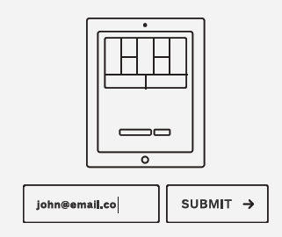
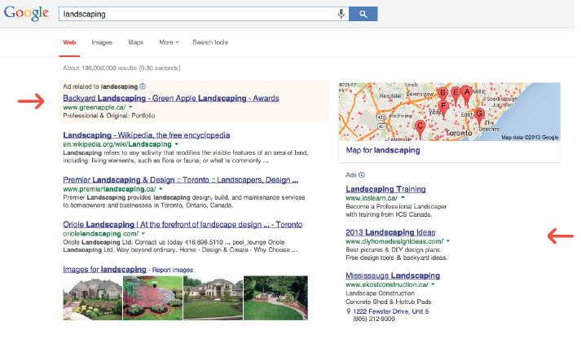
INTEREST & RELEVANCE
- Do potential customers show interest in your ideas
- Are your ideas relevant to them?
- Are they interested enough to perform an action?
Polls
Ad Tracking
Landing Pages
Notes:
O vosso trabalho aqui diria que se centra nestes testes e nos mais simples.
Inquéritos. Presenciais ou online (usar track para o link)
Tiram ou não os papéis? Ligam para saber mais informações?
Clicam nos anúncios?
Deixam o e-mail para receber mais informações?

Slide 30
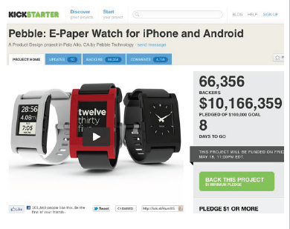

WILLINGNESS & ABILITY TO PAY
- Are potential customers interested enough in the features of your value proposition to buy?
- Will they put their money where there mouth is?
“Fake” Sales
Pre-Sales
Minimum Viable Products
Notes:
“Buy now” e depois pedimos o e-mail a dizer que contactamos logo que esteja disponível

Slide 31
PREFERENCIES & PRIORITIES
- Which features of your value proposition do potential customers prefer?
- What do they really value?
- What do they prioritize?
Split Testing
Innovation Games®
Notes:
Innovation Games® are a powerful technique popularized by Luke Hohmann that help you unearth, describe, and prioritize value propositions and features by using collaborative play with your customers.
PRODUCT TREE (FEATURES OF A VALUE PROP GROWING WITH TIME)
BUY A FEATURE
PRODUCT BOX

Slide 32
TESTING MY HYPOTHESIS

Slide 33
HOMEWORK
Get to know your industry and competitors
Select the 2 most relevant ones
Compare your project to those competitors
Build your comparable value curve and learn your strategy/value

Slide 34
EXERCISE & TEST
Built your 1st BMC
What are your hypothesis? Define all possible!
  Choose the 3 most important/risky ones!
If you can, interview someone that may be a client and LISTEN to their problems & needs BEFORE presenting them the solution!

Slide 35
EXERCISE & TEST
Prepare a google form questionaire
  Include this sentence in ALL your forms:
  “This is part of a student assignment for an entrepreneurial course in the FCUL, and the ideas, questions and all information herein contained is only theoretical and imaginary, not part of a yet real solution and it is of student’s entire responsibility. The purpose of this questionnaire is to listen to the market and potential customers needs on the bases of a fictional idea. We can assure you that every information here is maintained confidential and will solely be used with the purpose of getting statistical significant data.“
  Demographic info: name, age, degree, nationality, gender…
  Ask specific questions and provide optional answers (don’t do open questions)
    Ex: When you go to a new job outside your country what are the firts things you do?
      A) look for a place
      B) Know more about job
      c() learn the entry needs for that country...

Slide 36
EXERCISE & TEST
Collect as many answers as you can – Facebook, LinkedIn, email to groups, phone calls, presence interviews etc…
Analyse the data with the google summary tool
Validate or not validate your hypothesis!

Slide 37
INVENTIONS & PROTECTION
Protection guarantees some sort of exclusivity
Must we Protect EVERYTHING?

Slide 38
Intellectual Property
Intellectual Property (IP) protection guarantees the inventor of a new process or product to benefit from, or allow others to take profit from, the exploitation of that IP, either financially or other, preventing the possibility of unfair use of it by third parties.

Slide 39
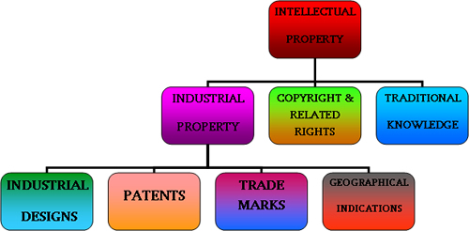

Slide 40
PATENTS
A patent is a monopolist right given to the inventor for a period of up to 20 years, depending on national laws, that is restricted to the details and claims defined in the patent’s document.
Only new, inventive and industrially suitable inventions can be patented.

Slide 41
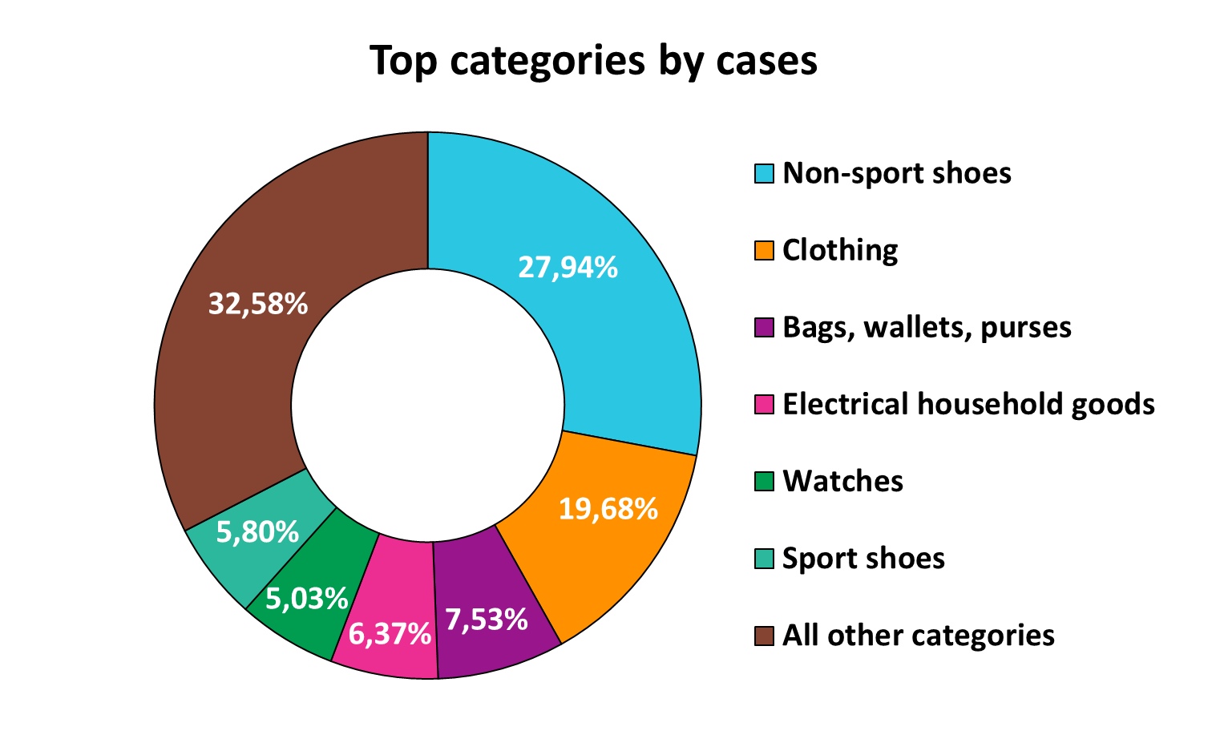

Slide 42
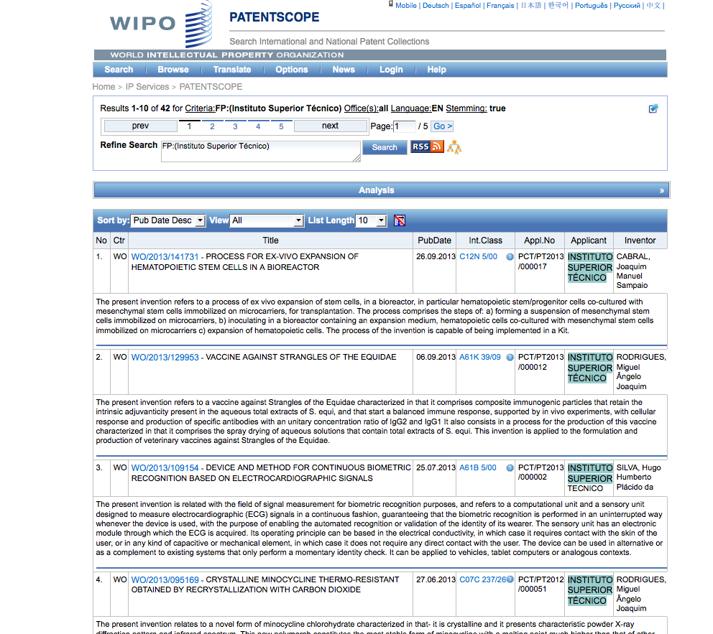

Slide 43
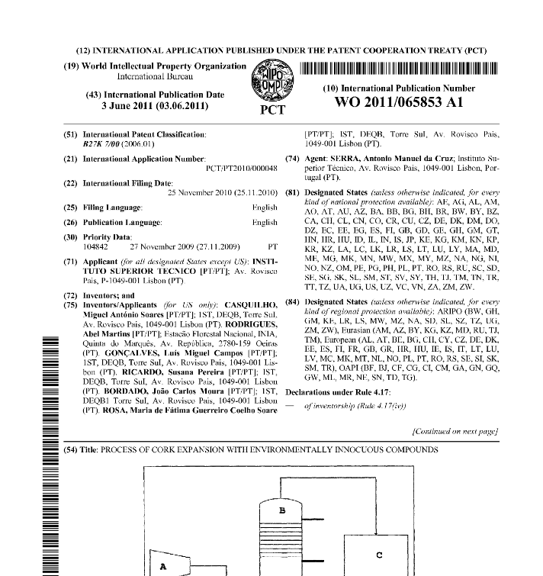
PATENTS

Slide 44
PATENTS
What can NOT be patented:
  Live organisms
  Original DNA sequences/genes
  Anything in nature
  Software
What CAN be patented:
  Uses/production methods of live organisms
  Modified/recombinant DNA sequences, vectors and methods
  Anything that is modified from nature
  Usage of a code/algorithm

Slide 45
PATENTS DATABASES
www.inpi.pt
www.wipo.com
https://www.epo.org/index.html

Slide 46
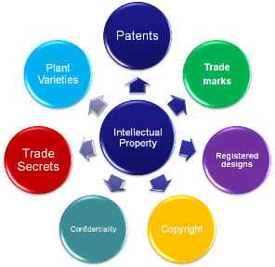

Slide 47
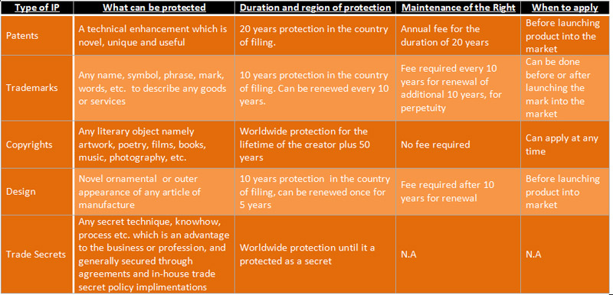

Slide 48
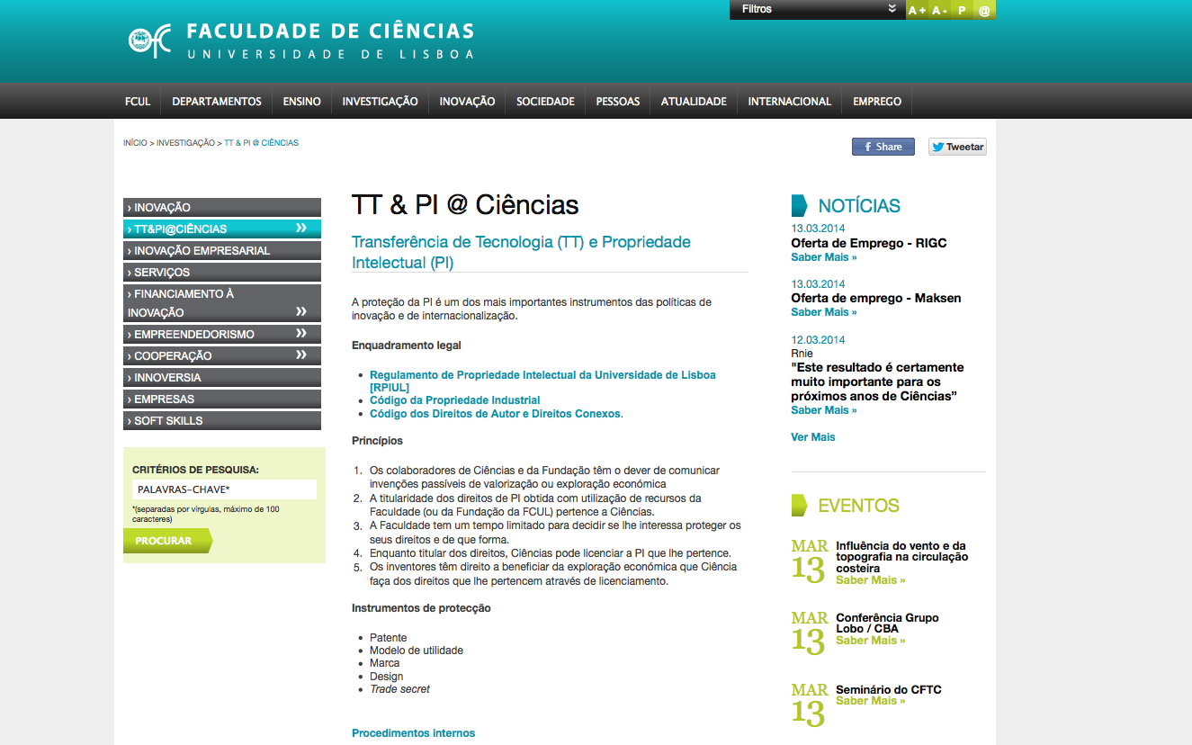
The IP CODE of ULISBOA
http://www.fc.ul.pt/pt/pagina/386/tt-pi-ciências

Slide 49
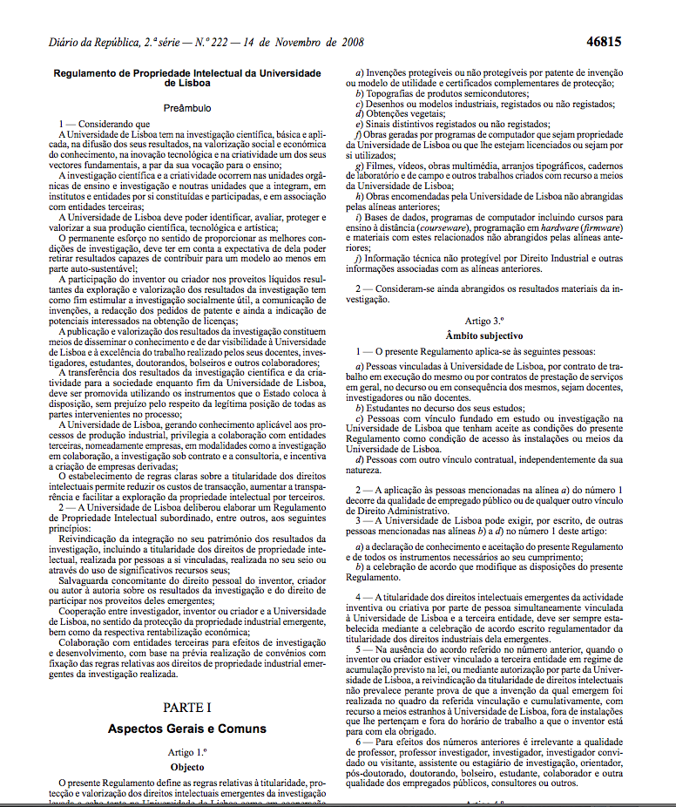
The IP CODE of ULISBOA
http://www.fc.ul.pt/pt/pagina/386/tt-pi-ciências

Slide 50
The IP CODE of ULISBOA
KEY POINTS
All the rights over R&D performed in UL belong to UL
The inventor has the right to be recognised as so in any IP piece or communication (or not if he/she desires so)
The inventor shall communicate the invention to UL (Via TT@UL) maximum 1 month after invention was made
If UL has no interest in protecting the IP, it can give partial or full rights to inventor
http://www.fc.ul.pt/pt/pagina/386/tt-pi-ciências

Slide 51
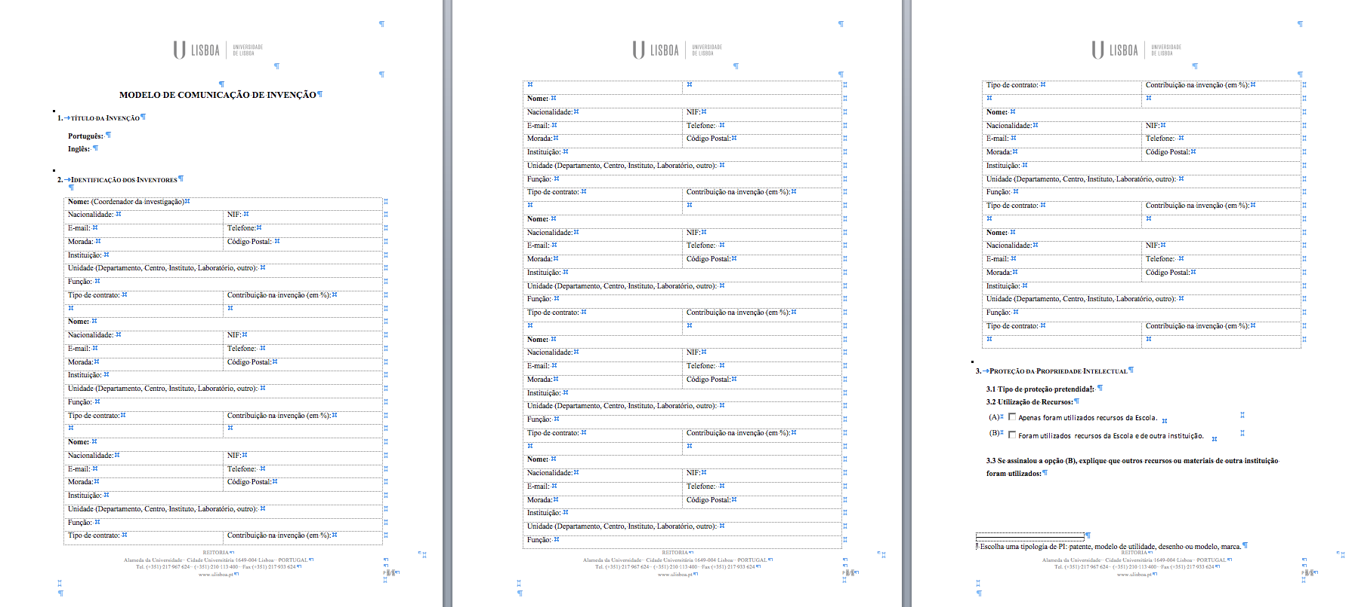
The IP CODE of ULISBOA
1st Step– Invention communication
http://www.fc.ul.pt/pt/pagina/386/tt-pi-ciências

